Slide 1
TEACHING KIDS TO CODE
Process and Path
[
]
JamesHandshoe

Slide 2
[
]
TEACHING KIDS TO CODE
Process and Path
Why?
Notes:
Why is it important to teach kids to code?
Currently more than 50% of current jobs require some technology skills and the US Bureau of Labor Statistics expects this to grow to roughly 77% within the next decade. I continually hear about the talent shortage in America…Image how hard it will be ten years from now!
CLICK

Slide 3
[
]
TEACHING KIDS TO CODE
Process and Path
Why?
Notes:
But there is an even bigger why, hahahaha, get it?
Teaching kids to code provides an opportunity to instill skills and concepts needed to be a learner. Not just educated but to develop command over individual learning and be prepared for the any future learning that may be thrown at them! Because <CLICK>

Slide 4
[
]
TEACHING KIDS TO CODE
Process and Path
The best learners – regardless of age, will be the best positioned for the future!

Slide 5
[
]
TEACHING KIDS TO CODE
Process and Path
PROCESS(Learning Theories and Teaching Techniques)
PATH(Learning Materials)
Practical Applications
Notes:
This talk will begin at a high level the process or learning theories, then move into teaching techniques and end with teaching materials and practical applications.
While we are working through these ideas I want you to keep in mind - How amazing would it be to inspire the next Mark Zukerberg or Linus Torvald?
What is exciting and encouraging is that each of us in this room can do something to slow the widening talent gap in technology while improving the ability to learn in our kids!
CLICK

Slide 6
[
]
TEACHING KIDS TO CODE
Process and Path
PROCESS
Notes:
The Process of teaching is how we do it. The steps to follow that will prime a student’s mind and belief that he or she can learn and develop mastery of hard concepts!
Today we will explore 3 critical learning concepts that have the potential to shift many paradigms in your views of intelligence. These are not new concepts. However, they are “old-school” concepts that are being reinforced by research.
<Click>

Slide 7
[
]
TEACHING KIDS TO CODE
Process and Path
Growth
Mindset
Carol Dweck
Notes:
First is the growth mindset. Carol Dweck, of Standford University has pioneered this research. Typically, people fall into one of two categories.
You either believe your intelligence or abilities are FIXED – you’re either born a genius, average or below average and that’s That!
Or you believe your intelligence or abilities are a starting point, that your efforts can Grow your intelligence.

Slide 8

[
]
TEACHING KIDS TO CODE
Process and Path
FIXED MINDSET |  | GROWTH MINDSET
 | SKILLS
 | CHALLENGES
 | EFFORT
 | FEEDBACK
 | SETBACKS
Something you’re born with
Fixed
Comes from hard work
Can always improve
Something to avoid
Could reveal lack of skill
Should be embraced
An opportunity to grow
Unnecessary
Something you do when
you are not good enough
Essential
A path to mastery
Useful
Something to learn from
Identify areas to improve
Get defensive
Take it personally
Blame others
Get discouraged
Use as a wake-up call to
work harder next time
Notes:
Skills, Challenges, Effort, Feedback and Setbacks are all areas that occur during the learning process. Regardless of age by the way!
I’d like to compare and contrast how the two mindsets view these areas. As we work through these, keep in mind that most often our mindset manifests itself subconsciously. Very rarely will it be an explicit response, however, actions and words reveal our Mindset.
Skills
<CLICK>In the Fixed mindset – You’re the lucky or unlucky one. You’ve hit the lottery
<CLICK>In the Growth mindset – Despite where you start you can improve from hard work!
<CLICK>In the fixed mindset - Challenges could expose your weaknesses because If I have to try hard I’m really not that intelligent or good
<CLICK>In the Growth mindset – Challenges, especially really tough ones, make my mind and abilities grow!
<CLICK>Effort, In the Fixed Mindset is what you do when your talent can’t magically get the job done
<CLICK>In the Growth Mindset effort is essential because the hard work improves abilities.
<CLICK>Feedback – Fixed Mindset – if someone points out that I need to improve they are essentially criticizing my intelligence
<CLICK>Feedback – Fixed Mindset – if someone points out that I need to improve I use that as feedback to learn and grow
<CLICK>Set Backs or Failures – Someone else was wrong. Wait….Am I really as smart as I thought I was?
<CLICK>Set Backs or Failures – Am I trying hard enough? Should I seek out advice? What can I do better?
Don’t these sound like issues a coder faces every day? I know I do – I fail every day! Sometimes I get mad at feedback but I force myself into the growth mindset and shift into what I know will accelerate my learning! <Click>

Slide 9
[
]
TEACHING KIDS TO CODE
Process and Path
Growth
Mindset
Practice
Theory
Carol Dweck
K. Anders Ericsson
Notes:
Once you believe you can Grow your intelligence and abilities, you can leverage the power of Practice Theory.
<Click>

Slide 10



[
]
TEACHING KIDS TO CODE
Process and Path
EXPERT
PRACTICE
10,000
hours
DELIBERATE PRACTICE
Notes:
You may have read Malcom Gladwell’s book Outliers where he describes the 10,000 hour rule. The idea that all it takes is 10,000 hours to become an expert.
This was grounded in K. Anders Ericsson’s work on practicing. It does take roughly 10,000 hours, but not the mindless punch the clock do my time practice. There will be some improvement but a student will quickly plateau. What is needed is Deliberate Practice and Purposeful Practice. These two approaches include a plan for improvement that targets weaknesses while utilizing the insights of a coach to direct our learning path. The practice theory takes the belief in the Growth Mindset and provides a concrete way to practice that leads to mastery.

Slide 11
[
]
TEACHING KIDS TO CODE
Process and Path
Growth
Mindset
Practice
Theory
Grit
Carol Dweck
K. Anders Ericsson
Angela Duckworth
Notes:
The last theory for this session is Grit. Our Catalyst Keynote speaker, Linda Kaplan Thaler, shared how the most ordinary people became extraordinary through this concept. Despite it being a concept that is old-school, we are now finding out how it can improve all facets of life from Angela Duckworth’s pioneering work in this field.

Slide 12


[
]
TEACHING KIDS TO CODE
Process and Path
G R I T
1. Find a passion, love or purpose
2. Frustration / confusion / practice are par for the course
3. Take risks and SHARE!
4. Failure is NOT the end
Notes:
<Click>
Find a passion or a love – this is what many of the greatest artist, athletes and intellectuals have fallen back to when failures occur
<CLICK>
Frustration
<CLICK>
Take risks and Share
<CLICK>
Failure is NOT the end!

Slide 13
[
]
TEACHING KIDS TO CODE
Process and Path
Two Teaching Techniques

Slide 14

[
]
TEACHING KIDS TO CODE
Process and Path
SCAFFOLDING
Notes:
Scaffolding is the sequence of steps needed to go from an introduction of a concept to the complex application of the concept. It can also be the steps to go from one concept to another.
Talk about Fizz Buzz – this has variables, comparison operators and conditionals, mathematical operators and a for loop.

Slide 15
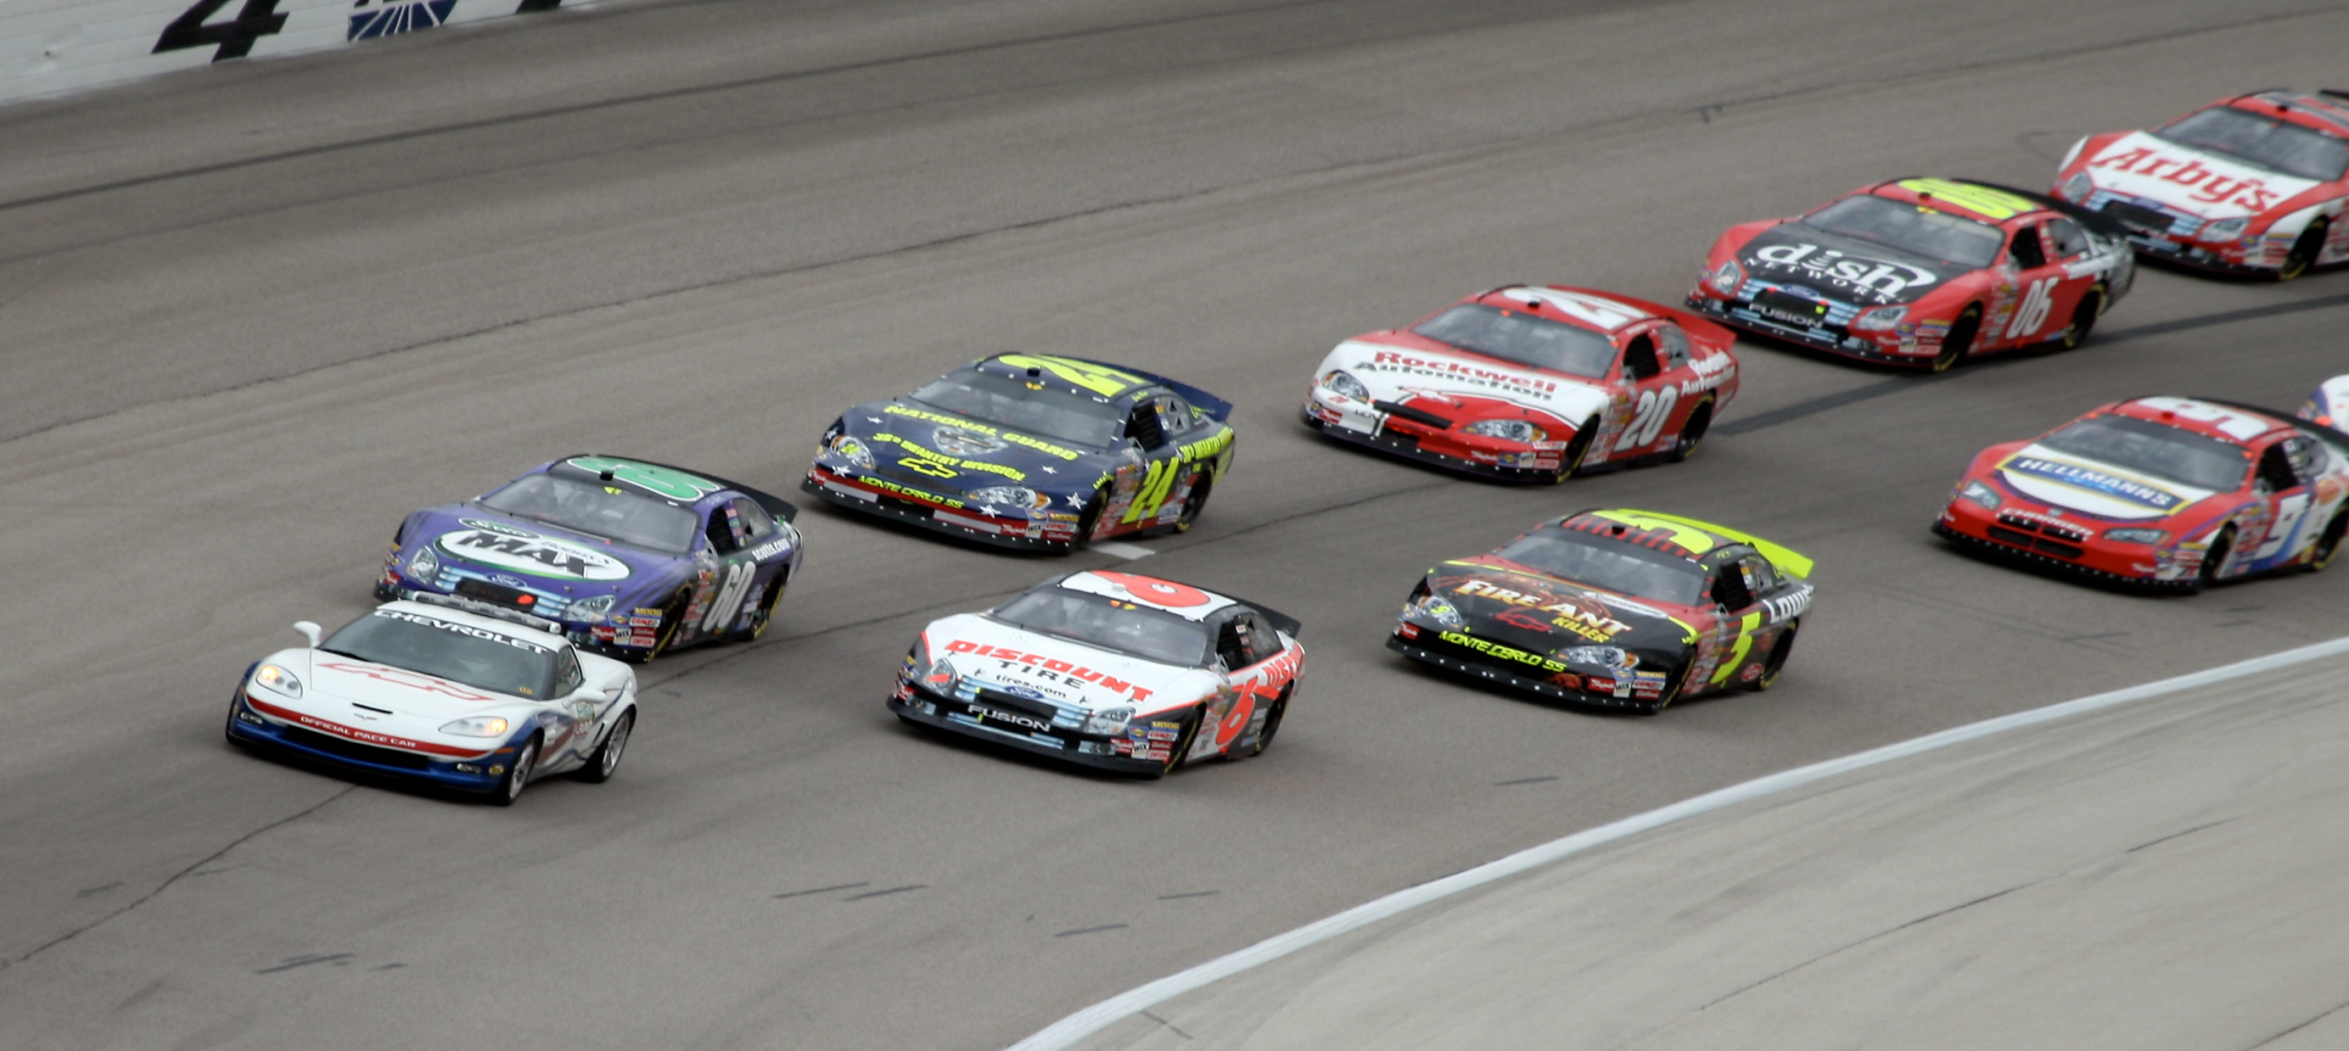
[
]
TEACHING KIDS TO CODE
Process and Path
PACING
Notes:
Pacing is the speed through which a student works through curriculum. This is where a mentor or a parent can help a learner move faster through curriculum or slow down to really understand a concept. I always explain pacing as the process to throttle up learning or throttle back learning. Working through curriculum at a break neck speed can lead to low levels of true understanding where moving too slowly can lead to boredom.

Slide 16
[
]
TEACHING KIDS TO CODE
Process and Path
PATH
Notes:
The next portion is Path – the actual items that could be used to help kids learn to code. This list is not exhaustive by any means but presents a great start to the items needed to introduce and teach coding concepts. For this talk, I’ve split the groups into
Birth – Elementary, Middle School and High School and for time, this talk will assume you start your child as a baby and work up to the high school level.
Keep in mind, that scaffolding and pacing should be used at each step of the way – the material is organized at a “suggested age level” but kids can use items from the different lists as a means of introduction or acceleration. For example, an elementary student could work from middle school or high school and vice versa. It is important to start at the appropriate level! Too hard too fast leads to an overwhelming experience. Too easy and too slow leads to boredom (Scaffolding and Pacing!)
<Click>

Slide 17

[
]
TEACHING KIDS TO CODE
Process and Path
BIRTH – ELEMENTARY
Notes:
First let’s examine Birth-Elementary <Click>

Slide 18
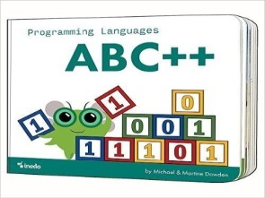

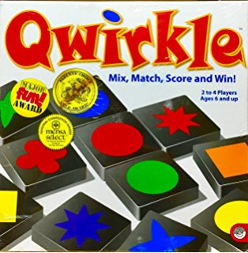


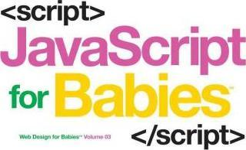

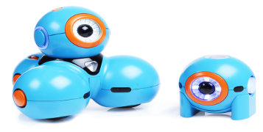
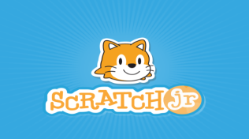
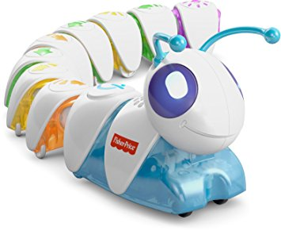


[
]
TEACHING KIDS TO CODE
Process and Path
{ age: “BIRTH – ELEMENTARY” }
Notes:
For each age group, I’ve included four types of items to create a path to help teach code directly or create a mindset to prime kids for coding.
<Click> First books. These books are really for younger kids – from birth – age 2. One great reason to introduce these books to young kids is because it acclimates them to coding concepts and vocabulary at a very young age. Just hearing and using these words makes teaching the concepts easier as they get older.
<Click> Next are some apps that help teach code. Scratch Jr. is Awesome! Explain scratch Jr. Tynker and Hour of Code provide similar online lessons. Save the animals is a great app for tablets.
**Talk about Carter here – include Grit and Growth Mindset
<Click> Code – a – Pillar: Robotics but teaches logic and how to sequence commands to move the robot. The blue robot is Dash and it incorporates a coding interface like scratch jr. where kids can code and learn how to control a robot. Very cool!
<Click> Lastly, I wanted to share some board games that teach concepts needed to code. Set Jr. and Qwirkle both develop pattern recognition in a fun way that an entire family or group of students can enjoy!

Slide 19

[
]
TEACHING KIDS TO CODE
Process and Path
BIRTH – ELEMENTARY
MIDDLE SCHOOL
Notes:
The next grouping is Middle School.

Slide 20
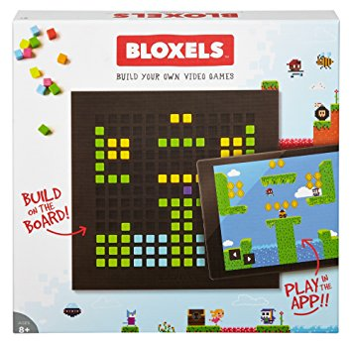
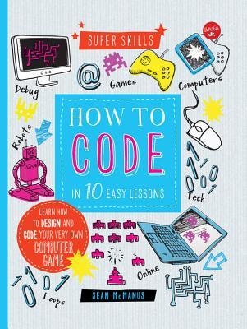
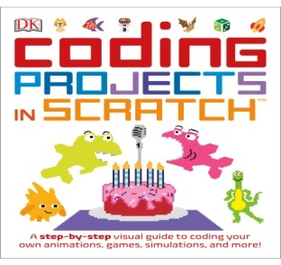
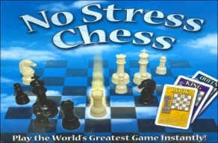
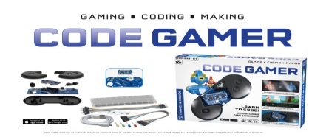
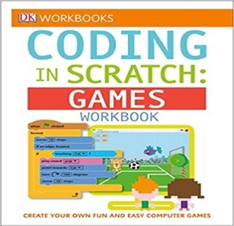

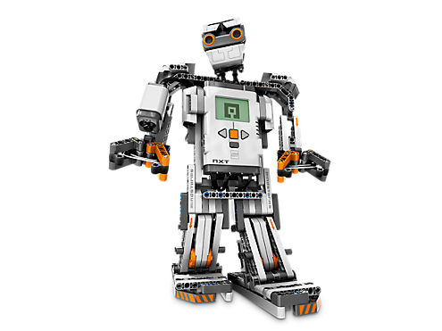
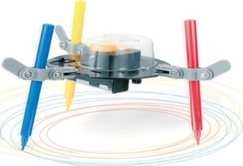


[
]
TEACHING KIDS TO CODE
Process and Path
{ age: “MIDDLE SCHOOL” }
Notes:
<Click>The books that I’ve included are awesome because they have lessons inside that a student can follow to create some really cool apps. Now, these are in the age group for middle school students but an elementary aged student that has taken off with coding can use these as well. Perfect example of pacing through a scaffolded curriculum for a kid that needs a more difficult challenge. Talk about Kyle and Ryne here.
<Click>These apps are similar to the ones in the Birth – Elementary category but they are more age appropriate. The Swift Playgrounds app is another example of an app that an elementary student can use as well. It moves fairly quickly and introduces functions but a great app for various levels. Kodu, is only for pc unfortunately, but is an awesome way for kids to build games. Scratch is the full version and is very elaborate in what it allows a developer to build.
<Click>Lego Mindstorms – Talk about Noah and how to build a robot to solve a rubics cube. 4M – Great way to get a student building – very maker space friendly. These types of robots help prepare students for IOT!
<Click>No stress chess – another game that can be introduced at the Elementary level. Chess helps teach pattern recognition and can reinforce the three learning concepts of Growth Mindset, Practice Theory and Grit. Code Gamer and Bloxels are great ways to teach coding through building video games.

Slide 21

[
]
TEACHING KIDS TO CODE
Process and Path
BIRTH – ELEMENTARY
MIDDLE SCHOOL
HIGH SCHOOL

Slide 22

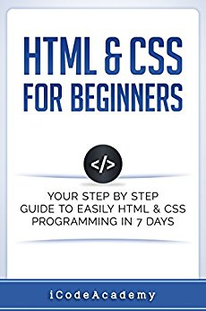

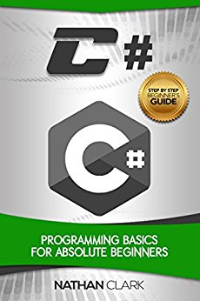
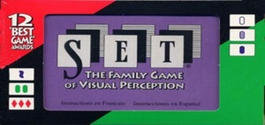

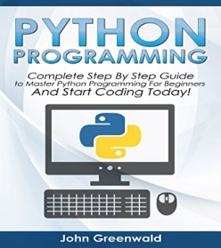
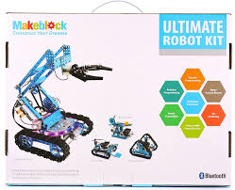
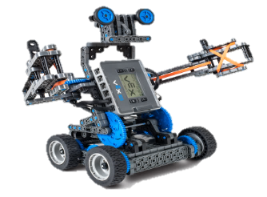


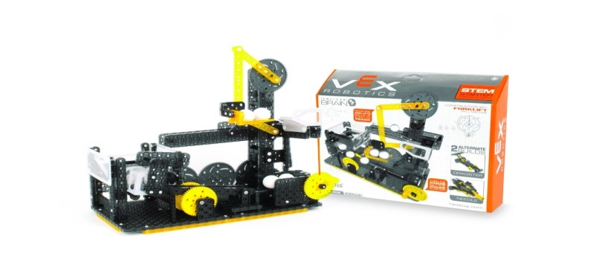


[
]
TEACHING KIDS TO CODE
Process and Path
{ age: “HIGH SCHOOL” }
Notes:
<Click>Books – these are more technical in nature but are still awesome resources to work through for an adult or student.
<Click>Learning Sites.
<Click>Robots – Vex clubs and competitions. Makeblock robots are similar to vex. Provide fun learning opportunities and an outlet for good competition and connections with other kids that have a passion for coding.
<Click>Set and Chess – pattern recognition with reinforcement of the Growth Mindset, Practice Theory and Grit. Able to measure how improvement occurs through playing and effort. Settlers of Catan – helps teach cooperation.

Slide 23
[
]
TEACHING KIDS TO CODE
Process and Path
How do I…

Slide 24
[
]
TEACHING KIDS TO CODE
Process and Path
How do I take my kids from playing
video games to making video games?
Notes:
Typically this is easier to accomplish at an Elementary to Middle School age level. High School ages students like making games but most of the time it is the ones that are really passionate about it. My best advice would be to make the process fun and exciting just like a video game. Different levels to work through – game plot, game design, etc. Start building it and playing it. Start small and monitor the process because if the scope of game is too great interest will wane quickly. In this instance, the first game should be super simple! That first accomplishment will help set the hook!

Slide 25
[
]
TEACHING KIDS TO CODE
Process and Path
How do I generate interest in programming
in a child that has no interest in programming?
Notes:
Start with a passion outside of coding. Maybe your son or daughter likes design or cars or art or fill in the blank. Despite not being passionate about coding, they most often are passionate about something. Brainstorm ways to highlight this passion through technology. If your son or daughter loves art, make a website to display his or her art. Does he / she love working on cars, well God knows I need as many videos as possible to help me work on a car so I can save some money! So please, help them make a youtube channel and a website to display how to work on a 2012 Malibu or a 2005 Town and Country.

Slide 26
[
]
TEACHING KIDS TO CODE
Process and Path
CLOSING TAKEAWAY
Notes:
Using the learning materials from this talk barely scratches the surface. Explore with you son or daughter and figure out new ways to continue learning. The most important piece to take away from this sessions is that believing you can change your abilities, intelligence or skill motivates a kid to do! When your son or daughter starts coding, use scaffolding and pacing to maximize this practice time! And lastly, help develop Grit in your son or daughter by sharing failures! Building these attributes in your son or daughter will prepare a fertile mind for learning many hard tasks.
A man whose name is synonymous with genius, Albert Einstein, once said,
“It’s not that I’m so smart, it’s just that
I stay with problems longer.”

Slide 27
[
]
TEACHING KIDS TO CODE
Process and Path
Any questions?

Slide 28
[
]
TEACHING KIDS TO CODE
Process and Path
Session Website
http://bit.ly/2wSKVG4

